Slide 1
Woodlands CS Club
Web Dev
2021-01-25
Group B

Slide 2
Before We Start
Hope everyone has taken some time in the past week to look into Web Dev
Any questions for GNU/Linux? Problems? Questions? Something random?
Any questions about Web Dev?
We will be covering on HTML and CSS today, hopefully everyone will be comfortable with these two languages after the meeting
Select next week's topic here: https://forms.gle/o5ANABuPToAyRpE67
Demo after the presentation :)

Slide 3
Meeting Overview
Prior knowledge of basic HTML, what HTML/CSS are
HTML elements, tags
Basic formatting (bold, italics, etc.)
(Full Reference: https://www.w3schools.com/tags/default.asp)
In this meeting, we will cover more advanced CSS
HTML classes
CSS colours, fonts
CSS positioning, margins, padding, align
Making an image gallery (demo)

Slide 4
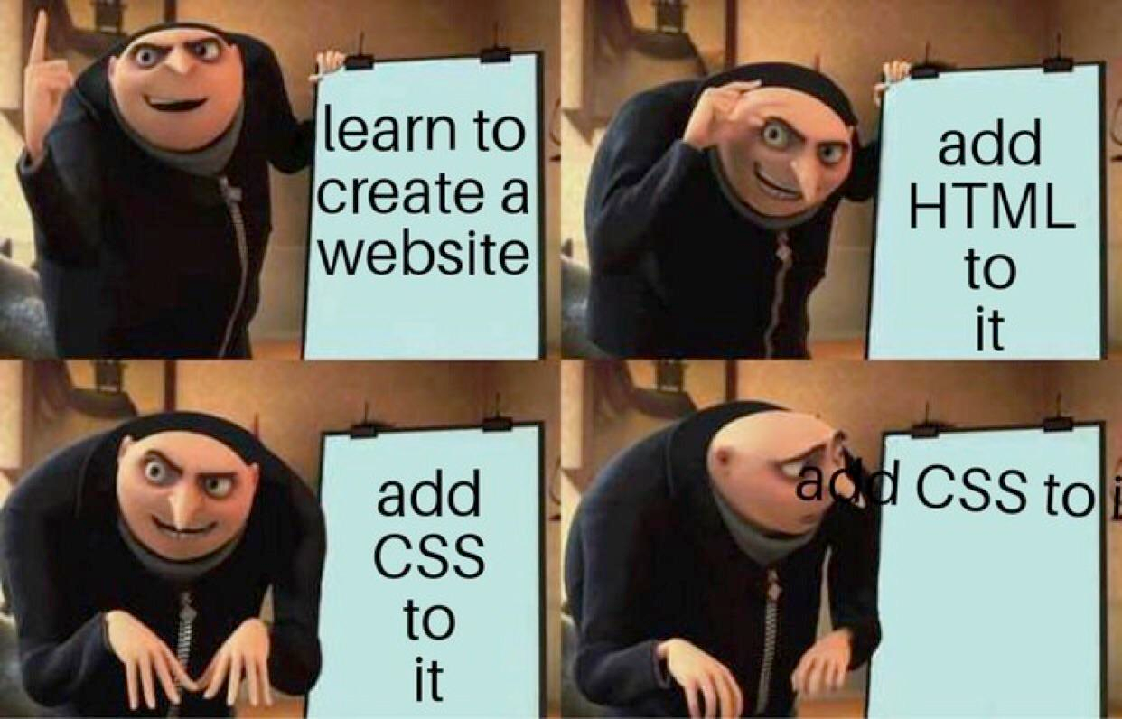
HTML Review
<tag>Content</tag>
HTML elements can contain other elements.
<ul> <li>Coffee</li> <li>Tea</li> <li>Milk</li> </ul>
HTML elements can by styled with CSS.
<p style="color:red">CS Club</p>

Slide 5
Common HTML Tags
html - should be the tag that wraps everything
script - run something that is Javascript
a - a link to somewhere
div - a divider that is usually used to separate the content
head and header - some metadata and non-content information related to the page
h1 to h6 - some header on the page; like for a title of a paragraph
p - a paragraph
svg and img - an SVG or some display a image (found at some link)
Note: there are sometimes "non-standard" tags which are used by various web frameworks. eg: YouTube

Slide 6
HTML Formatting
<b> - Bold text
<strong> - Important text
<i> - Italic text
<em> - Emphasized text
<mark> - Marked text
<small> - Smaller text
<del> - Deleted text
<ins> - Inserted text
<sub> - _{Subscript text}
<sup> - ^{Superscript text}
Source: https://www.w3schools.com/html/html_formatting.asp

Slide 7
HTML Classes
Ref: https://www.w3schools.com/html/html_classes.asp
HTML elements can have a "class" attribute.
<div class="shadow"> <p>This has a shadow on it!</p> </div>
These classes can be modified using CSS.
.dropshadow{ box-shadow: 0px 0px 25px rgb(255,255,255,0.8); border: solid 3px rgb(0,0,0,0.8); }

Slide 8
HTML ID
Ref: https://www.w3schools.com/html/html_id.asp
Similar to class, but unique
<div id="main-navigation"> <p>This has a shadow on it!</p> </div>
These IDs can be modified using CSS.
#main-navigation{ text-align: center; border: solid 3px rgb(0,0,0,0.8); }

Slide 9
Using CSS
CSS changes the way the browser displays HTML
To use CSS, use the following syntax
The selector specifies what criteria is needed for the styles to apply to; they can be very specific or even unspecific (such as *)
[selector]{ [declaration 1]: [value 1]; ... [declaration n]: [value n]; }

Slide 10
CSS Text
CSS fonts are specified using the font-family property. Five main families:
Serif
Sans-serif
Monospace
Cursive
FANTASY
p{ font-family: "Times New Roman", Times, serif; }
Notes: the different entries in this setting states to use the first listed font but keep trying in this specific order if a font could not be found.

Slide 11
CSS Positioning
Block vs Inline
Block elements start on a new line and take up the full width of the screen
Inline elements do not start on a new line and take up only the space they require
Block elements include <div>, <h1>, <p>
Inline elements include <img>, <span>, <a>

Slide 12
CSS Positioning (cont.)
HTML elements can be positioned using the top, bottom, left, and right properties. There are five different position values:
Static, not affected by those properties
Relative, positioned relative to its static position
Fixed, positioned relative to the viewport
Absolute (usually bad practice), positioned relative to the closest positioned parent element (could be "html" which is based on the view port of the page)
Sticky, functions like relative normally and then fixed at the edge of viewport

Slide 13
On to the Live Demo...

